Slide 1

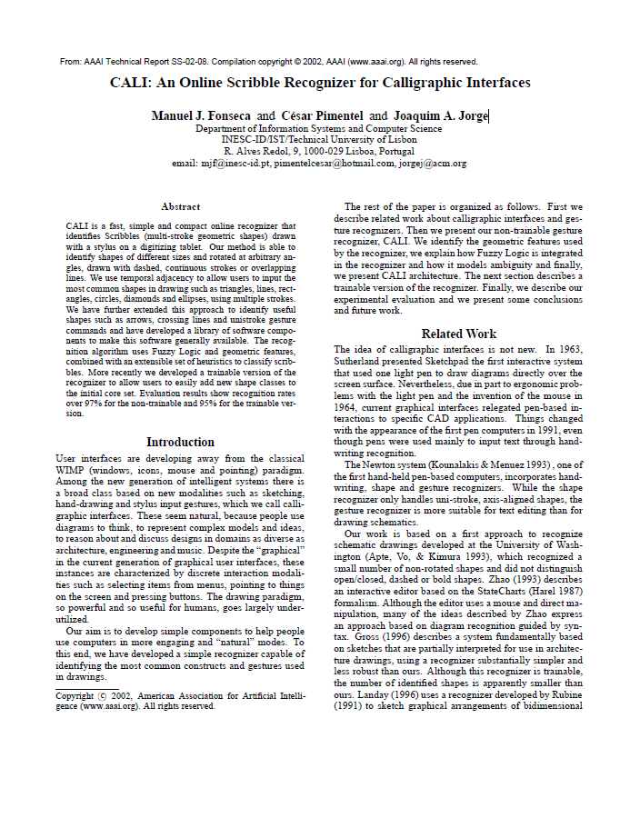
CALI: An Online Scribble Recognizer for Calligraphic Interfaces
Paper by Manuel J. Fonseca and C´esar Pimentel and Joaquim A. Jorge
Presentation by Beau De Clercq

Slide 2
Roadmap
Problem at hand
Solution
Extension
Experimental results

Slide 3
Problem at hand
Recognizing most common constructs and gestures in drawings

Slide 4
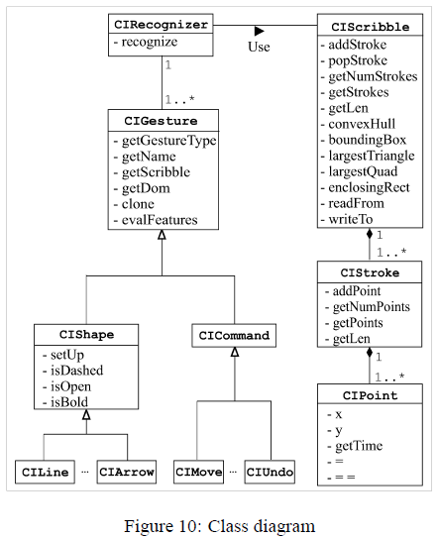
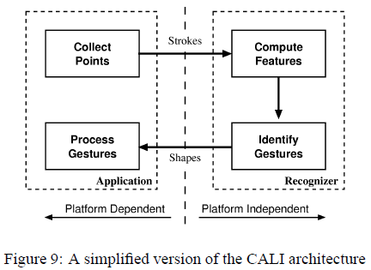
Solution – CALI

Slide 5
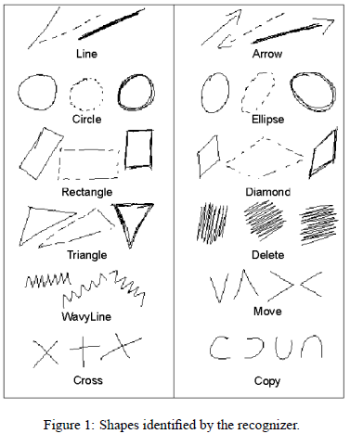
Solution
Based on Apte, Vo, & Kimura Recognizing Multistroke Geometric Shapes: An Experimental Evaluation
Non-trainable recognizer
Global geometric properties
Filters
Fuzzy logic
Notes:
The algorithm works by collecting strokes from a digitizing tablet. A stroke is the set of points from pen-down to pen-up.
We collect strokes into scribbles until a set timeout value is reached. Recognized scribbles are classified as shapes.
A shape associates a scribble with a class (e.g. Triangle) and a set of geometric attributes, such as start and end-points and bounding box.
The recognizer works by looking up values of specific features in fuzzy sets associated to each shape.

Slide 6
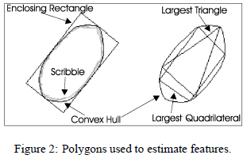
Solution – geometric properties
Compute
Convex hull
Largest area triangle
Quadrilateral
Smallest area enclosing rectangle

Slide 7
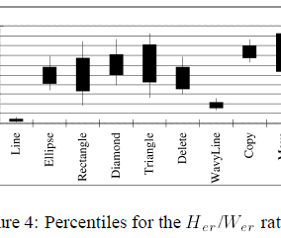
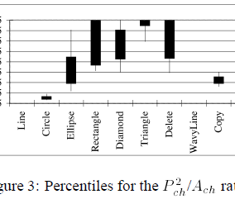
Solution – filters
Aspect ratio
Thinness ratio
Compares the height of the enclosing rectangle with its width
area of the convex hull and its perimeter squared, is used to distinguish Circles from other shapes

Slide 8
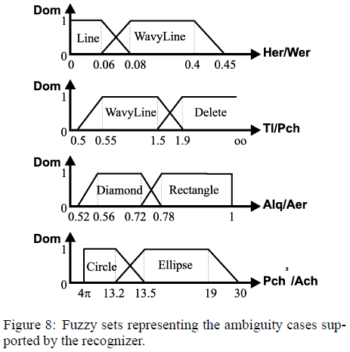
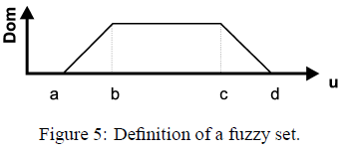
Solution – fuzzy logic
Fuzzy sets
Identify shapes
Avoid mistakes
Sets defined by test subjects
Solve ambiguity
Notes:
Avoid using too many sets.
A fuzzy set is defined by four values, as depicted in Figure 5. After selecting the features for each shape, we compute these four values based on the percentiles.
Values b and c correspond to the 10% and 90% percentiles respectively, and a and d to the “minimum” and “maximum” after we have identified outliers in each distribution.
Removing these outliers minimizes confusion between different shape families, which rises from overlap in distributions. Thus, there is a tradeoff in designing fuzzy sets from statistical data.
If a and d are set very wide apart the recognition rate increases, as well as the number of false positives.
“Narrower” values decrease the number of false classifications at the cost of a much lower recognition rate.

Slide 9
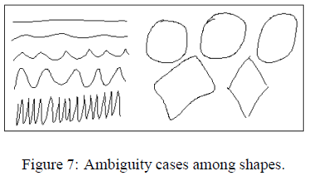
Solution – deriving results
ANDing memberships of sets

Slide 10
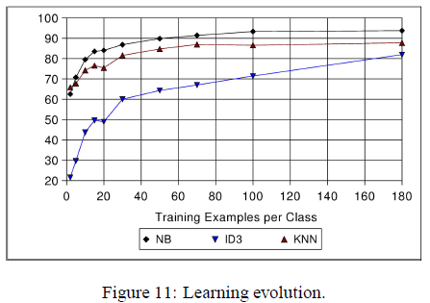
Extension – trainability
Use mache learning techniques
KNN
Good efficiency and fast but memory hungry
NB
Average efficiency and fast, low complexity
ID3
High efficiency, acceptable complexity

Slide 11
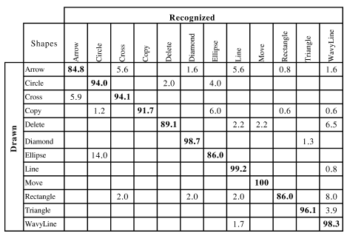
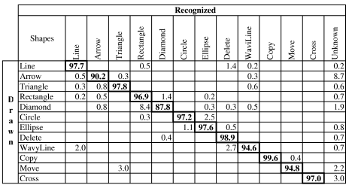
Experimental results
Non-trainable
trainable

